Slide 1
to-do list
Elvis nunez

Slide 2
Social challenge addressed
How society nowdays does not know how to manage their time
The society tends to waste their time doing unbeneficial things, instead of priotirizing the

Slide 3
The solution
I decided to create a to do list to help what people must prioritize and keep track of what they are doing and what they need to do after other tasks.

Slide 4
Software created
A to-do list with a few user fliendly functions
It was created using Tkinter and different functions from other libraries.

Slide 5


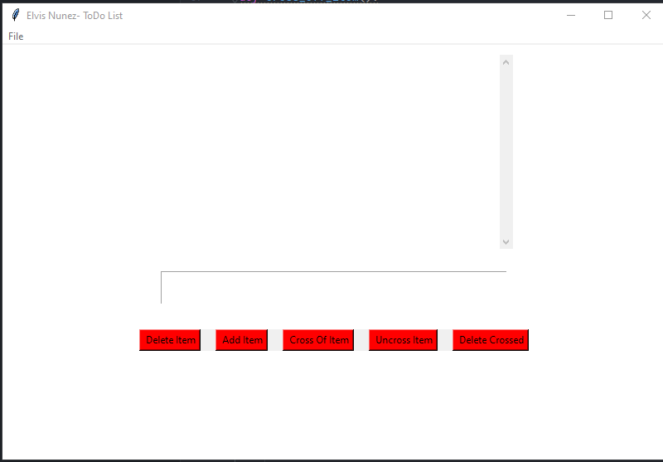
Features of the program

Slide 6
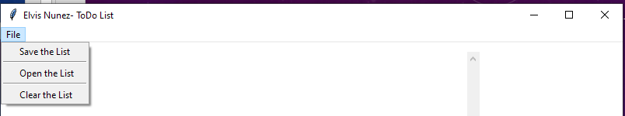
Navigation bar for the user

Slide 7
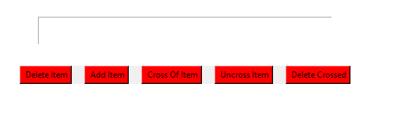
Input from the user and features for the list

Slide 8

Thank you

